Slide 1

Control statements 3
Kia Babashahi Ashtiani

Slide 2
Review
Selection control statements
Counter control statements
Sentinel control statements
Specifically
While
Break
Switch case

Slide 3
This time
Continue
Incrementation and decrementation operations
Do while
For loops.

Slide 4
Breaks
Lets first talk about break.
Break, brook out of the entire loop if a particular condition was not being satisfied.
Example: The user must input 5 numbers. If the user inputs all 5 numbers, then you terminate the program printing: Success. If however, it happens that while entering numbers, the user enters 50, you will break out of the loop. Once out of the loop, the statement: ” 50 resulted in a break” will be displayed if entering 50 was the result of the break and If all 5 numbers were read successfully and none of them were 50, print success.

Slide 5
Problem break down
Take a minute to design the algorithm or flow chart of this problem.
Try to code it yourself.
First you need a counter control statement to count from zero to 5 when reading numbers.
If you see number 50, break.
But once you are out of the loop how do you know what caused the termination?
Use flags.

Slide 6
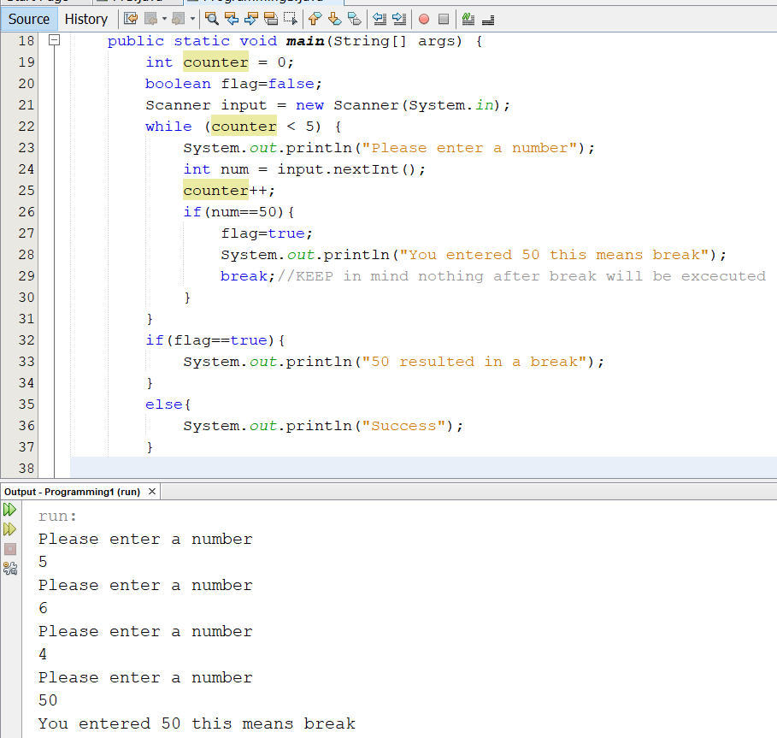
Flags
Using flag you can track what was the cause of exiting the loop.

Slide 7
Continue
Break:
Jumps out of the entire loop.
All the commands after the keyword break in the scope of the repetition statement and future iterations of the loop will not be executed.
Continue:
When you want to skip a particular iteration of the loop after a condition has been satisfied.
But want to stay in the loop for the rest of the iterations when the condition is not satisfied.

Slide 8
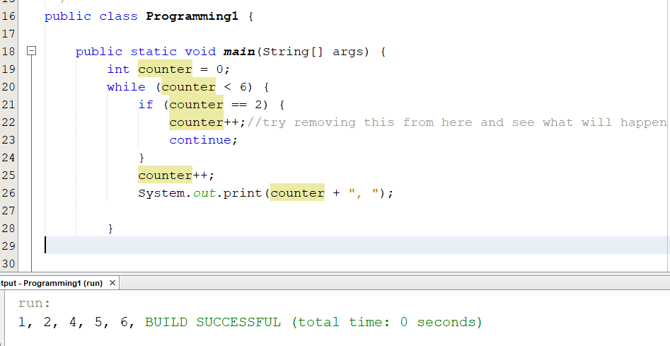
Continue
Print all the numbers from 1 to 6 but in case you see 3, don’t print it.

Slide 9
counter++ and counter— ++ counter and --counter
The ++ operator is used to increment the value of the value of the counter variable by one.
Similarly the -- operator is used to decrement the value of the counter variable by one.
These operators are unary operators.
These unary operators can show up behind or after a certain variables.
Depending on where they are placed, they will have a different name and application.

Slide 10
Meaning
Application | Name | Application
++Counter | Prefix increment | First add 1 and then use the new value
Counter++ | Postfix increment | Use the current value then add 1
--Counter | Prefix decrement | First subtract 1 and then use the new value
Counter-- | Postfix decrement | Use the current value then subtract 1
Fun fact: C++ means C+1 and Both are programming languages.

Slide 11
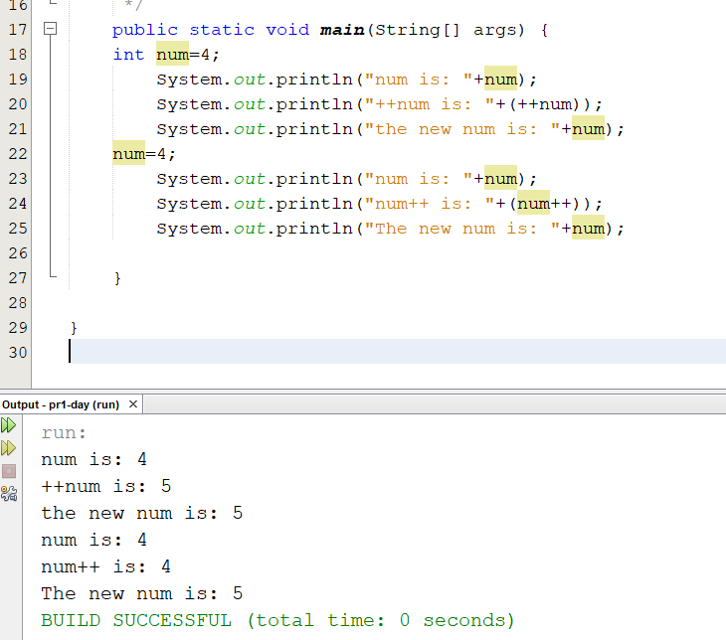
Num++
Try -- at home ☺
++ and -- only and only work on variables and not on numbers .
In terms of precedence of operators, they are above multiplication. So first these then the rest.
The last ones are +=,-= ,…. .
The Idea of this slide was taken from the slides and the book of Ditel and Ditel.

Slide 12
Do While
With while, first a condition was verified and evaluated.
If the condition was true, then you entered the body of the control statement.
If it was not true, you did not execute a single command in the body of the while control statement.
Do while is similar to while. Except that, it goes through the body of the loop first and then tests the condition for future iterations.
In other words, in a do-while statement, you start your first iteration without checking the condition. So execute the body at least once then continue doing it while a statement is true.

Slide 13
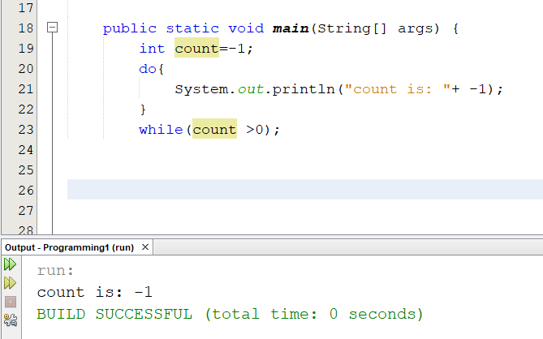
Do while code
In a while statement what is inside of do, would not be executed.
Pay attention to the ; after while.
It is better coding to add the {}

Slide 14
For repetition statements
The last repetition statement for this course is called the for repitition statement.
It is a counter control repetition statement.
When working with counter control statements using while, you initialized the variables and defined them outside the while condition, then executed the body of the loop and tried to ensure that you change the counter at the end to avoid an infinite loop.
In for, you can have a more compact version of the above.

Slide 15
While
type variable =intial value;
While (variable < a certain number){ // it can also be more or >=, <=
preform some operation;
Increment the variable;
}

Slide 16
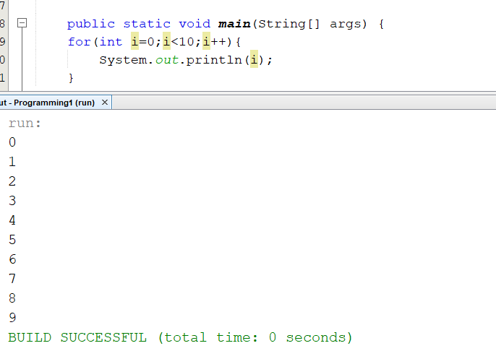
For code 1
int i is defined and initialized inside of the for loop.
Then the condition is checked. If true, we enter the body.
Once the body is done, the control variable is incremented (i++)
The loop condition will be re-tested.
You can also declare I outside and initialize it in the loop.

Slide 17
Scope of a variable
Where you can use it.
If a variable is defined between { } of a given control statement. Or inside the () of a for loop it is local to that scope and can only be used there.
i in the previous example is only accessible in the scope of the for loop. Don`t believe me?
Write i++; outside the body of the loop so try this :
for(int i=0;i<10;i++){
System.out.println(sth);
}
i++; Error will be displayed because i is not defined outside the scope of the {}.

Slide 18
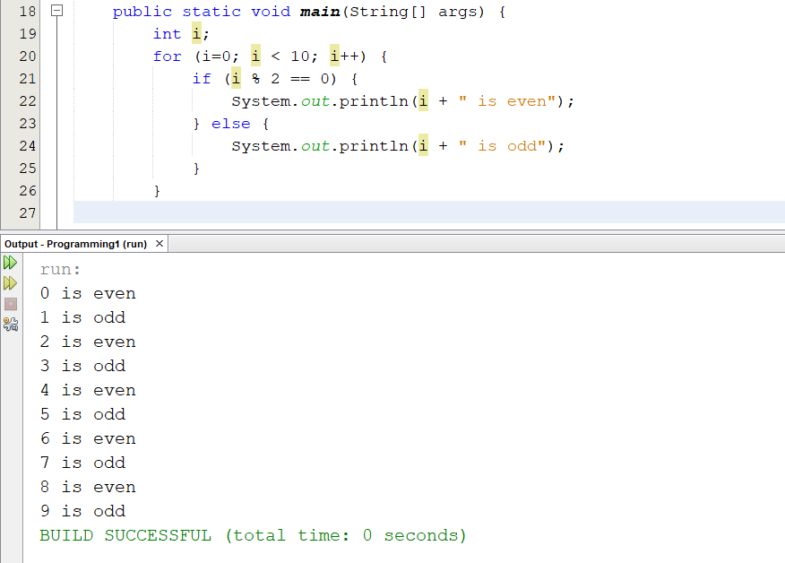
For code 2
int I has been defined outside.
i is later initialized to 0;
The scope of I in this case is the entire main function.
Try writing i++; after the for loop and then you see it will work.

Slide 19
For vs while
Most of the things you can do with a for statement, you can also do with a while statement.
Remember for is a counter control statements and while can also count as a counter control statement.
Normally, when we want to use counter control statements we use for since it is more convenient but for sentinel control we use while.

Slide 20
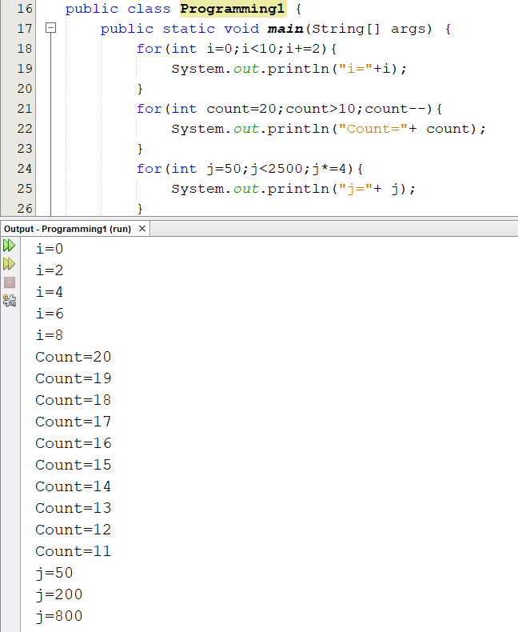
Other things you can do in the for loop
You can use different step lengths do increment or decrement you can do it one by one, two by two or they way you like.
In the lab hours we will see how you can define and initialize your loop variable outside of for and leave the first part of the loop statement empty and it will work:
Int i=0
For(;i<10;i++){
Print(sth);
}
Can you also leave the i++ part empty? If so, what do you need to do?
The only mandatory part is the condition

Slide 21
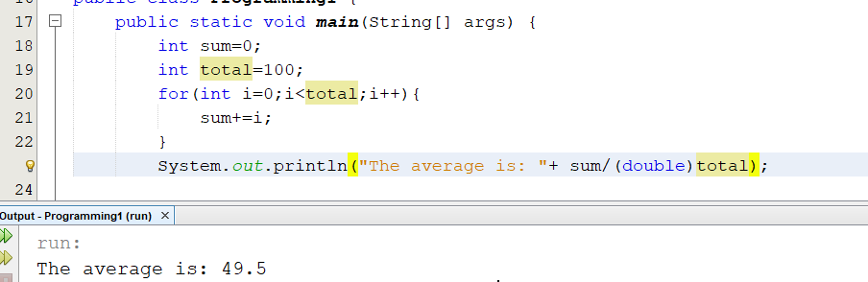
For, example
Use for from now on to do most of the counter control operations .

Slide 22
summary
Control statements:
Selection statements:
if-else
Switch case
Repetition statements :
While
Counter control and sentinel control
do while
Counter control and sentinel control
For
Counter control

Slide 23
Summary 2
Break: Exits the control statement
Continue: Skips one iteration
++, -- : unary incrementation and decrementation operators.

Slide 24
Next time
Methods and functions

